Slide 1
APS1051 Final Project: ETF Clustering
Sebastian Tampu (1004928572)

Slide 2
Introduction
Overview
Focus on identifying ETFs that align with rotational momentum strategies.
Application of clustering techniques to find ETFS with similar performance characteristics.
Importance of Study
Effective ETF selection is crucial for optimizing investment portfolios.
Rotational momentum strategies rely on the ability to select and rotate into high-performing ETFs.

Slide 3
Objectives
Primary Goals
Identify ETFs that exhibit similar performance to the original set of sector and government bond ETFs.
Evaluate the effectiveness of hierarchical and k-means clustering techniques.
Secondary Objective
Determine the optimal configuration for use with the rotational momentum strategy with this portfolio.

Slide 4
Background
The rotational momentum strategies can be summarized by rotating between assets based on recent performance, aiming to capture momentum from high-performing assets.
ETFs provide diversified exposure across sectors and are suitable for momentum strategies due to their liquidity and variety.
It is critical to identify ETFs with consistent performance, ensuring the portfolio remains aligned with market trends.
ETFs can react differently based on sector and market conditions. Selection must account for economic cycles and sector rotation.

Slide 5
Data Collection
The data is historical ETF data from Yahoo Finance.
Data spans January 30th, 2016, to January 30th, 2020.
ETFs Used:
21 sector ETFs and 7 government bond ETFs given from class as comparison targets.
49 additional ETFs included to enhance analysis and to broaden scope. Captures a wider range of sectors and asset classes.
Daily price data, returns, and volatility were collected to assess ETF performance and risk.

Slide 6
Methodology Overview

Slide 7
Clustering Techniques
Hierarchical clustering groups ETFs based on returns and volatility similarities.
K-means clustering segments ETFs into predefined clusters with minimal variance.
Both methods applied to identify ETFs with similar performance characteristics.
Clustering results are used to explore relationships among ETFs and inform strategy.

Slide 8
Modified Rotational Momentum Program
Program rotates ETFs based on recent momentum to capture high performance.
Evaluates different configurations of lookback periods, holding periods, and weights.
Designed to identify the best-performing ETF combinations over the selected period.
Program output informs ETF selection for optimal portfolio management.

Slide 9
Evaluation Metrics
Silhouette score assesses the quality of ETF clustering for both methods.
Sharpe Ratio measures the risk-adjusted return of the rotational momentum strategy.
Higher scores indicate better-defined clusters and more effective strategies.
These metrics are used to compare the different configurations and refine the analysis.

Slide 10
Results

Slide 11
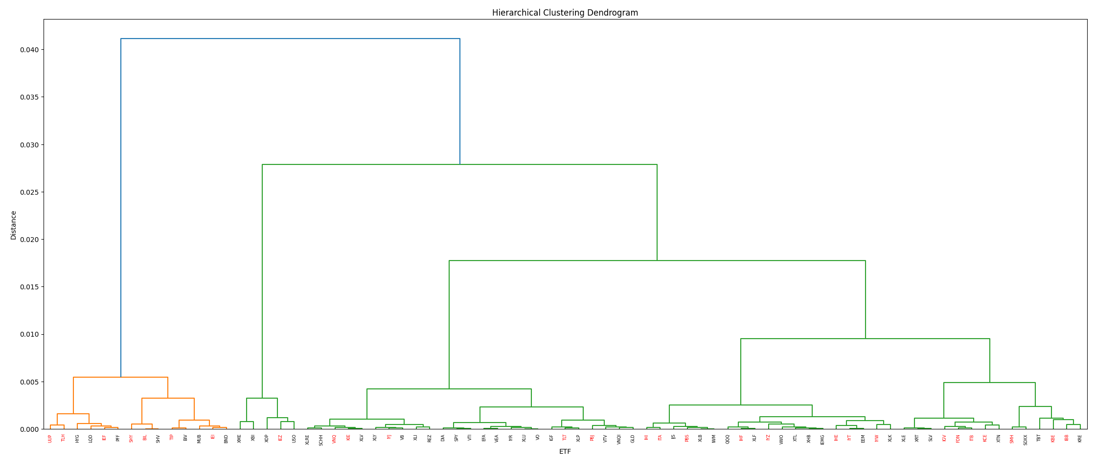

Slide 12
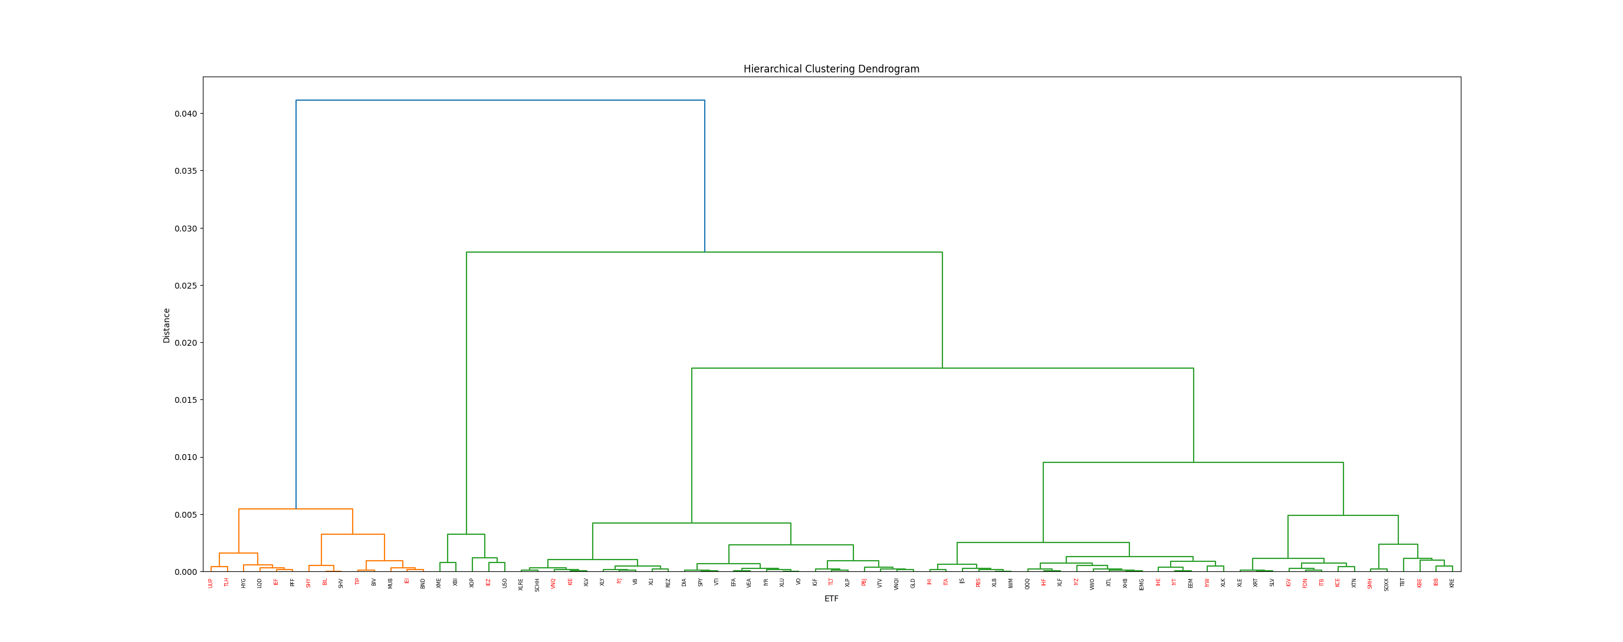
IEF & PFF
IEF provides stable income from U.S. Treasury bonds, while PFF offers higher-yield income from preferred stocks.
Both are interest-rate sensitive, appealing to income-focused investors seeking low volatility.
TIP & BIV
TIP adjusts for inflation with TIPS, BIV provides stable income through intermediate-term bonds.
Both protect against inflation, serving complementary roles in a diversified bond portfolio.
IEI & BND
IEI focuses on U.S. Treasuries, BND offers broad bond market exposure, including Treasuries and corporates.
Both provide core fixed-income exposure, balancing safety with income generation.
* All red ETFs in this and future diagrams are from the group of 21 sector ETFs and 7 government bond ETFs.

Slide 13
IIEZ & USO
IEZ invests in oil equipment and services companies.
USO tracks the price of crude oil futures.
Both are closely tied to the energy sector, with performance driven by oil prices and industry demand.
XOP, which is the next most similar to these, invests in oil and gas exploration and production companies.
All three are highly correlated with oil prices, with IEZ and XOP tied to industry performance and USO directly linked to the commodity's price.

Slide 14
KIE & XLV
KIE focuses on the insurance sector, while XLV targets the healthcare sector.
Both sectors offer defensive characteristics, with KIE tied to financial services stability and XLV benefiting from consistent healthcare demand.
IYJ & VB
IYJ invests in industrial companies, while VB focuses on small-cap stocks across various sectors.
Both ETFs provide exposure to economic growth, with IYJ driven by industrial activity and VB offering diversified small-cap exposure that can benefit from broad market expansions.
TLT & XLP
TLT holds long-term U.S. Treasury bonds, providing interest rate sensitivity, while XLP invests in consumer staples, offering stable, non-cyclical exposure.
TLT is seen as a safe-haven asset during market downturns, while XLP benefits from consistent consumer demand, making both defensive plays but in different market contexts.

Slide 15
IHF & XLF
IHF targets the healthcare providers and services industry, while XLF focuses on the financial sector.
Both ETFs offer exposure to sectors tied to essential services, with IHF linked to healthcare demand and XLF to financial market stability and growth.
IYT & EEM
IYT invests in transportation companies, while EEM focuses on emerging markets equities across various sectors.
IYT is closely tied to economic activity and trade, while EEM offers growth potential from developing economies, making them complementary in capturing global economic trends.
IYW & XLK
IYW focuses on the technology sector, particularly companies driving innovation, while XLK provides broader technology exposure, including established tech giants.
Both ETFs offer exposure to tech sector growth, with IYW tilted towards innovation leaders and XLK offering more diversified, blue-chip tech exposure.

Slide 16
KCE and XTN
KCE focuses on capital markets companies, while XTN invests in the transportation sector.
Both ETFs are economically sensitive, with KCE linked to financial markets activity and XTN tied to the movement of goods and people.
SMH and SOXX
SMH and SOXX both target the semiconductor industry, investing in companies involved in chip design, manufacturing, and distribution.
Both ETFs provide exposure to the same high-growth sector, with slight differences in holdings, but they are both driven by the global demand for semiconductors.
IBB and KRE
IBB focuses on the biotechnology sector, while KRE targets regional banks within the financial sector.
IBB is driven by innovation in healthcare, particularly in biotech, while KRE reflects the health of regional economies through banking activity, offering diversification between healthcare innovation and financial stability.

Slide 17
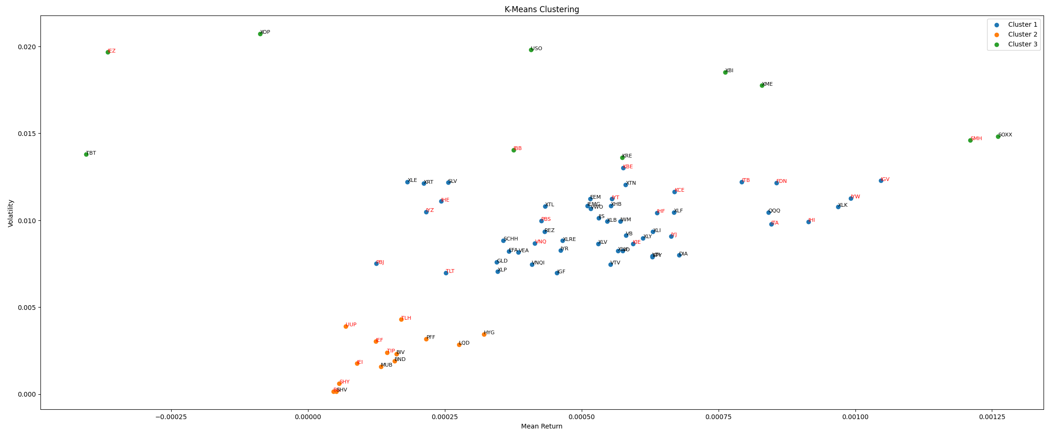

Slide 18
Cluster 2 was the most tightly packed or similar out of all the cluster, representing a good mean location.
Going by mean-return and volatility, all these ETFs are fairly similar to each other.
The most similar are BIL and SHV, also present in the hierarchical clustering on slide 12.
TIP and BIV, which were discussed on slide 12, are also visibly very close in this cluster.

Slide 19
For Cluster 1, also including some of Cluster 3 at the top, we see that the K-means algorithm does not as good of a job.
It does seem as if there are around 4 visible clusters in this image, one on the right, one on the left, and two near the middle. As such, experimenting with more clusters or centroids might have been a good idea.
KRE and KBE, which together with IBB, were very close in the hierarchical cluster, are now further apart and KBE in a different cluster altogether.

Slide 20
Clustering Comparisons
Hierarchical clustering produced strong clusters with a silhouette score of 0.668, effectively grouping ETFs with similar performance characteristics.
K-means clustering achieved a slightly lower silhouette score of 0.643, still providing some meaningful insights into ETF similarities.
Both methods identified ETFs with similar risk-return profiles, but hierarchical clustering offered more distinct group separations, especially in identifying new ETFs similar to the original set.

Slide 21
Best Performing Configuration
The best configuration achieved a Sharpe Ratio of 1.342, indicating a strong balance between risk and return.
The optimal parameters were:
Lookback Period: 25 days
Holding Period: 2 weeks ending on Fridays
Weight Distribution:
0.4 for short-term returns
0.2 for long-term returns
0.4 for volatility

Slide 22
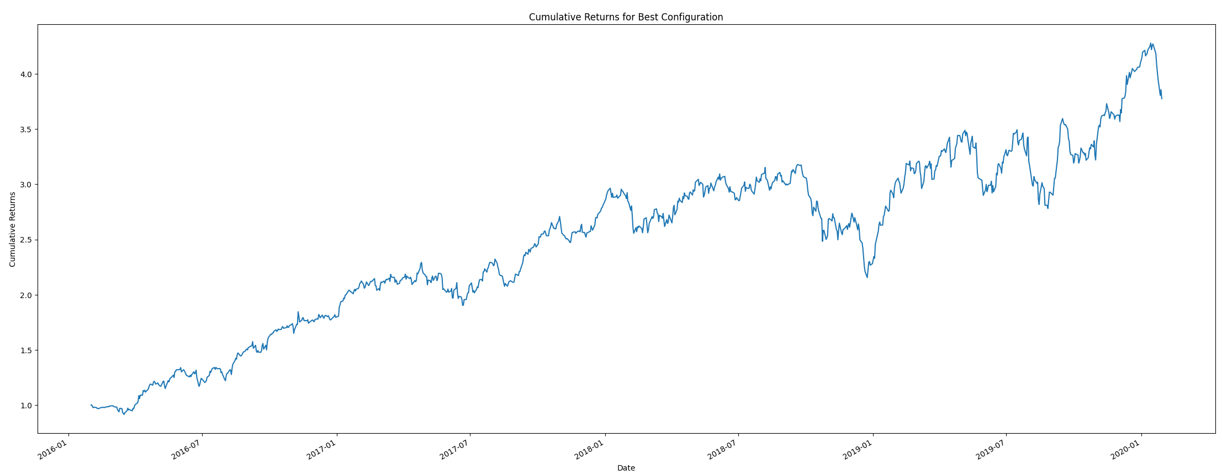

Slide 23
Limitations and Future Considerations
Limitations:
The analysis is based on historical data, which may not fully predict future performance.
Clustering results depend heavily on the chosen metrics and period, potentially leading to different groupings under varying conditions.
Future Considerations:
There are more alternative clustering methods that could be explored to refine ETF groupings.
The dataset can be expanded to include more recent data or different time frames for robustness.

Slide 24
Conclusion
ETFs similar to the original set were successfully identified using hierarchical and k-means clustering techniques.
The optimal configuration achieved a strong Sharpe Ratio, validating the effectiveness of the rotational momentum strategy.
The analysis provides potentially valuable insights for ETF selection, offering a different approach to optimizing investment portfolios.

Slide 25
THE END
Thank You!

